Slide 1
Control Interface for Autonomous Delivery of Magnetically Stimulated Particles
Spring 2019
In-Progress Presentation
MAGNETO
Weinberg Medical Physics Sponsors Dr. Chad Ropp, Olivia Hale, Dr. Lamar Mair, Brad English, Dr. Irving Weinberg
GMU Senior Design Team Elizabeth Ankrah, Minh Quan Do,
Victor Huynh, Bassam Mutawak
GMU Advisors Dr. Nathalia Peixoto, Dr. Qi Wei
Notes:
Victor

Slide 2
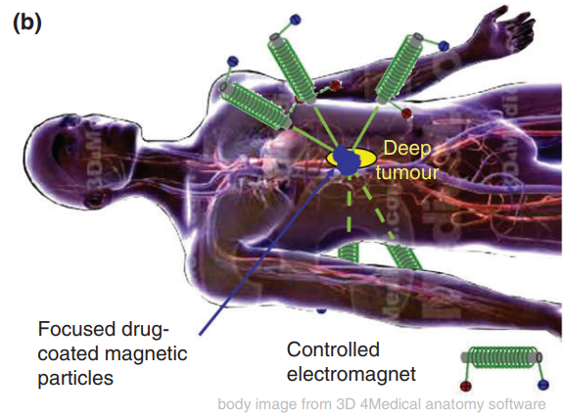
Background - Magnetic Particle Delivery
Significance:
Transport of magnetic nanocarriers via external magnets
Form of noninvasive surgery (carriers loaded with therapeutic payloads)
Limitations:
Crossing physiological barriers
Magnetic field attenuation affects deeper delivery
Operating magnet arrays manually is impractical
Fig 1. Using magnetic fields to focus therapy to a deep tumour[1]
Notes:
Lizzy

Slide 3
Problem Definition
WMP is designing an MRI-guided magnetic control system (MCS) to overcome delivery limitations. Automation of system operation is key for practical MCS implementation.
Project Magneto lays MCS foundation for
automation behavior, control flow, and user interaction.
Notes:
Lizzy

Slide 4
Project Relevance
Magneto is a C++ software interface that controls WMP’s 4-coil array system for autonomous delivery of a magnetic object. It serves:
To be a software precursor to WMP’s future surgical MCS.
To improve control of the 4-coil array system used in WMP’s pilot experiments.
Notes:
Lizzy

Slide 5
Objectives
Design software control interface with relevant, easily portable features for WMP’s future MCS.
Automate and improve accuracy of particle translation using WMP’s 4-coil array system.
Notes:
Lizzy

Slide 6
Fall 2018 Recap
Developed initial GUI prototype satisfying basic requirements
Requires significant functional and design improvements
Implemented image subtraction for particle detection
Consistent but mandates static background
Developed particle translation surface fitting model
Performed with fairly low accuracy (i.e. overshooting and undershooting)
Implemented initial hardware control scheme
computer → arduino → motor controllers
control was functional but overly rigid and simplistic
Notes:
Victor

Slide 7
Requirements
GUI:
Optical Image Streaming
Consistent Particle Detection
User Path Drawing and Discretization
Operation Controls (Start/Pause, Stop, Force Terminate)
Operation Automation
Data Collection and Exporting
Run Efficiently (on WMP computers)
Hardware Control:
Simultaneous Control of Multiple Motor Controllers
Bidirectional Communication with GUI
Control Scheme is Operating System Independent
Notes:
Victor

Slide 8
GUI Metrics
Speed
Measured via elapsed
timers placed within
the code (i.e. times for
startup, hardware
communication, etc.)
Performance
Measured via CPU and
Memory usage
statistics
Functionality
Measured via users
tests and Task
Completion Rate (TCR)
User Satisfaction
Measured via numerical
user scores obtained
through two
questionnaires
Notes:
Lizzy
A functional task is defined as interacting with a GUI widget produce a desired output (ex. pressing “Connect Camera” button results in camera images being streamed and displayed on the GUI in real-time).

Slide 9
Hardware Metrics
Motor Controller
Communication Rate
Definition: time delay between two consecutive commands without loss of information
Measured via elapsed timers placed within the
code
Simultaneous Command
Execution Delay
Definition: time difference between simultaneous commands
Measured via elapsed timers placed within the
code
Notes:
Lizzy

Slide 10
GUI Design
Objective: In addition to satisfying all established requirements, develop in Qt to provide an intuitive user experience.
Major Areas
UI Layout
Setup
Path Drawing
Operational Control
Data Collection
Notes:
Victor

Slide 11
Old UI Layout vs...
Figure 2. 1st semester GUI consisted of 3 full-sized windows (main, pathing, and particle detection) with numerous buttons. Transitioning between windows resulted in longer, more tedious user experience and caused issues with data field shuffling and resizing.
Notes:
Victor

Slide 12
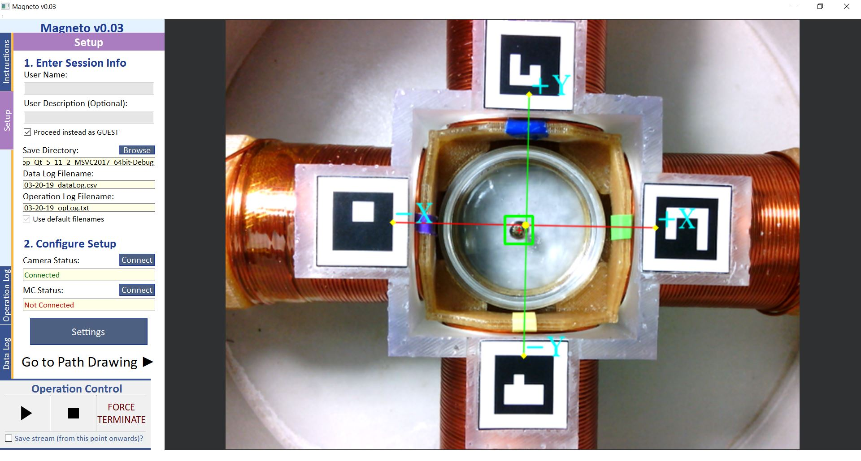
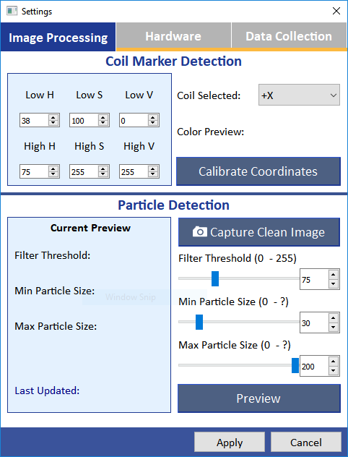
New Layout!
Figure 3. New GUI consists of 1 full-sized window (main) and 1 mini-window (settings). Use of a tabwidget allows for fitting more content into a more compact screen region. Stream display screen size is much larger here than in the 1st semester GUI.
Notes:
Victor

Slide 13
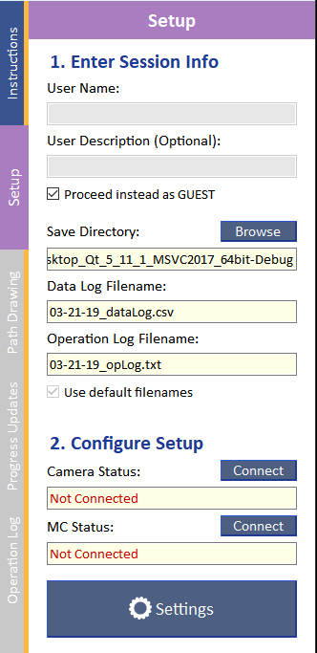
Setup
Figure 4. Setup before drawing the delivery path is simplified into 4 main steps:
1) Specifying the folder in which to export data files (or leaving as default).
2) Connecting the camera and hardware via quick button presses.
3) Calibrating the coordinate system and configuring particle detection.
4) Changing other settings from their default values.
Notes:
Victor

Slide 14
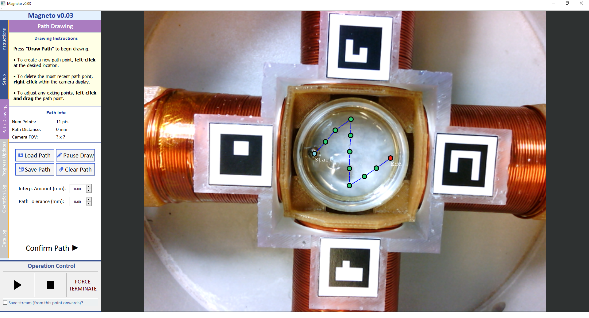
Path Drawing
Figure 5. Drawing the delivery path uses graphics scene tools rather than etching a path onto the displayed image. This allows for manipulation of path points (e.g. dragging and dropping). Also, drawn paths can be saved and loaded into the GUI.
Notes:
Victor

Slide 15
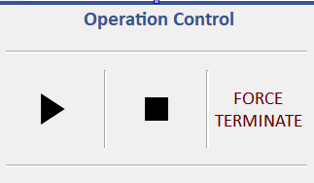
Operation Control
Figure 6. Operation control panel becomes enabled after setup and delivery path confirming.
Start/Pause
Pausing the operation is the only way for the user to modify settings mid-operation.
Force Terminate
This immediately ends the operation with improper closeout. Used only for emergencies.
Stop
Stopping the operation ends it with proper closeout (to both software and hardware). If the particle reaches the path end, the operation is stopped automatically.
Notes:
Victor

Slide 16
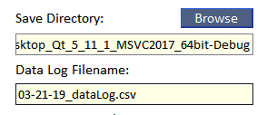
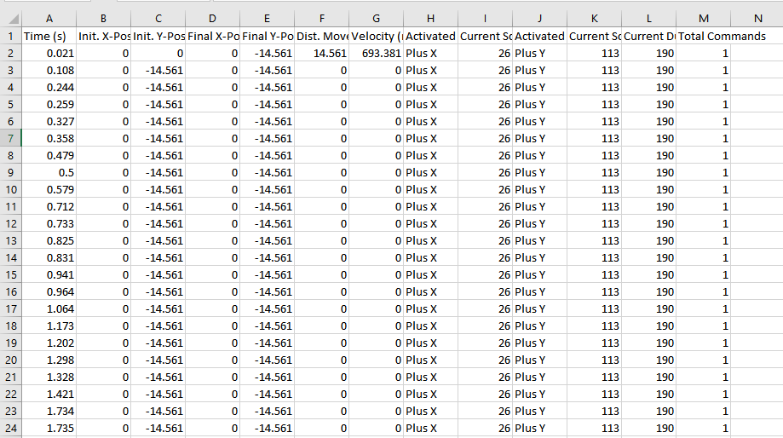
Data Collection
Figure 7. A data entry is generated for each streamed frame and contains information such as timestamps, particle location, current values sent to the hardware, etc. The data log is formatted as a .csv file.
Notes:
Victor

Slide 17
GUI Testing To-Date
Lag Time Measurements of Significant Functions
Function | Avg Lag Time (ms) | Standard Deviation (ms)
Startup | 1287.1280 ms | 16.5940 ms
Camera Connection | 987.3840 ms | 182.7573 ms
Motor Controller Connection | 10.8091 ms | 0.5863 ms
Opening Settings Subwindow | 52.3760 ms | 2.1065 ms
Starting/Pausing System Operation | 1.9845 ms | 0.5634 ms
Stopping Further Hardware Execution | 0.0932 ms | 0.0808 ms
Table 1. Lag times for significant GUI functions were collected to assess the software’s speed. The times for the most intensive functions were ~1000 ms. Some standard deviation values are large in comparison to the corresponding lag time, but this is negligible due to how short those lag times are.
Notes:
Victor

Slide 18
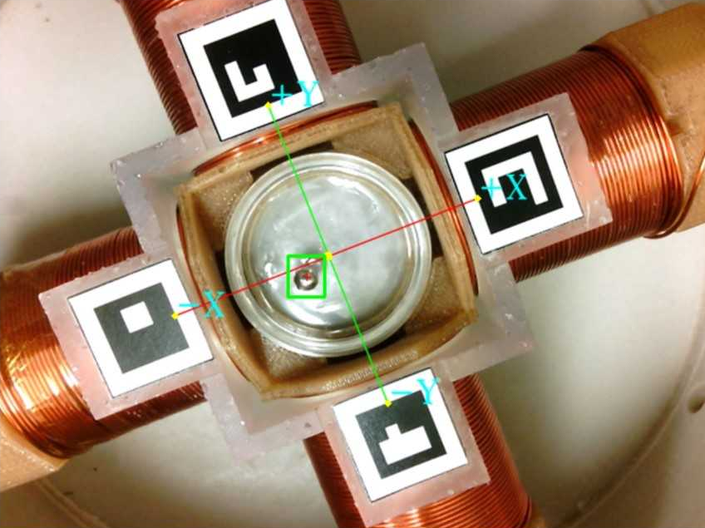
Image Segmentation Design
Objective: Detect particle and coil locations within streamed optical images consistently with minimal delay.
Particle Localization Alternatives:
Image Subtraction
Template Matching
Hough Circles
Coil Localization Alternatives:
Color Thresholding
ArUco Markers
Figure 8. Detected particle and coil locations within petri-dish setup
Notes:
Lizzy

Slide 19
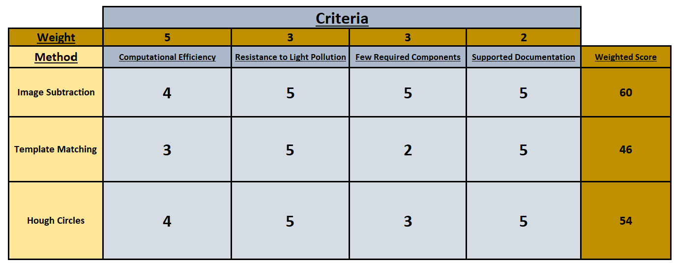
Image Segmentation Design (Particle)
Table 2. Particle localization methods weighted decision matrix
Notes:
Lizzy

Slide 20
Image Segmentation Design (Coil)
Table 3. Coil localization methods weighted decision matrix
Notes:
Lizzy

Slide 21
Image Segmentation Testing To-Date
Characterized particle localization deviation:
Recorded detected particle location per frame over a testing period (1.0 minute) under different lighting conditions
Dark Room (2 Lux), Lit Room (89 Lux), Direct Light Source (350 Lux)
A total of 900 frames (and subsequent particle locations) for each environment
Characterized coil localization deviation:
Recorded each detected coil location in all incoming frames over a testing period under different lighting conditions (identical to above)
A total of 100 frames (and subsequent coil locations) for each environment
Notes:
Bassam

Slide 22
Image Segmentation Testing Results
Table 4. Standard Particle Localization Deviation For Each Preliminary Lighting Environment
Table 5. Standard Coil Deviation Localization For Each Preliminary Lighting Environment
Notes:
Bassam

Slide 23
Translation Model Design
Objective: Establish a methodology for accurately translating the magnetic particle through a user-defined path using a solenoid coil array.
Regression Neural Network:
Surface fitting proved to be slightly inaccurate, requiring further modification of any outputs
Can be used as a “black-box” method to model multiple factors affecting translation
Established a more effective data collection procedure for optimal results
Notes:
Minh

Slide 24
Neural Network - Architecture
Neural Network for Current Scale
Inputs: Initial coordinates (mm), Desired coordinates (mm)
Output: Necessary current scale (0 - 127 unitless)
Two hidden layers, each with 20 neurons
Four total networks to be trained, one for each solenoid
Neural Network for Current Duration
Inputs: Initial and Desired coordinates (mm), Desired current scale for each solenoid
Output: Necessary current duration (ms)
One network to be trained and implemented for entire system
Notes:
Minh

Slide 25
Neural Network - Preprocessing
Chi-Square feature selection
Z-score normalization of all values in the training set
Dataset of size 11,000 containing particle translation data, 80% used for training and 20% testing
Notes:
Minh

Slide 26
Neural Network - Training
Model trained for maximum of 1000 epochs
Metrics used for training termination:
Mean-squared error (MSE)
Mean-absolute error (MAE)
Training stops early if MSE and MAE does not decrease for 10 consecutive epochs
Loss function is mean-square-error
Notes:
Minh

Slide 27
Neural Network Testing To-Date
Metric used for evaluation of model:
R² Correlation coefficient
R² value of 1.0 signifies 0% error between predicted values and expected values
Our model has R² value of 0.75.
Notes:
Minh

Slide 28
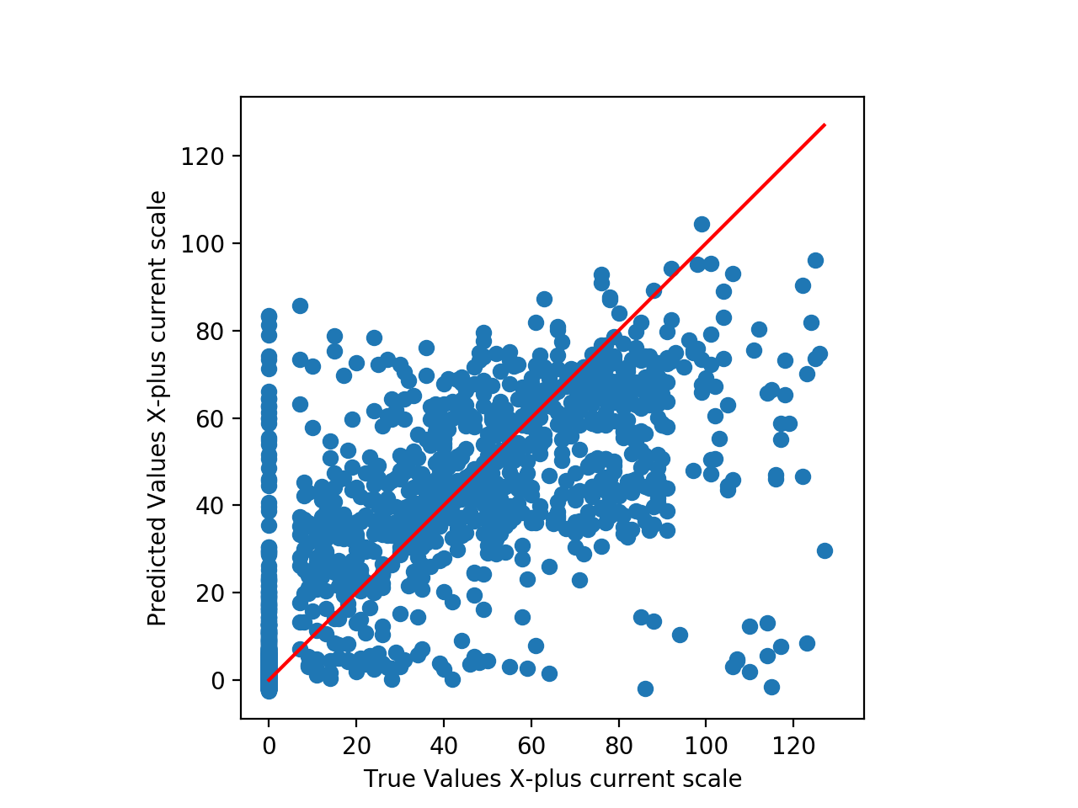
Translation Model Results
Figure 9. Predicted vs. Expected current scale for one coil. If every value was predicted correctly the R² value would be 1.0. The higher the R² value, the more the points would cluster around the red line, the better the performance of the model.
Notes:
Minh

Slide 29
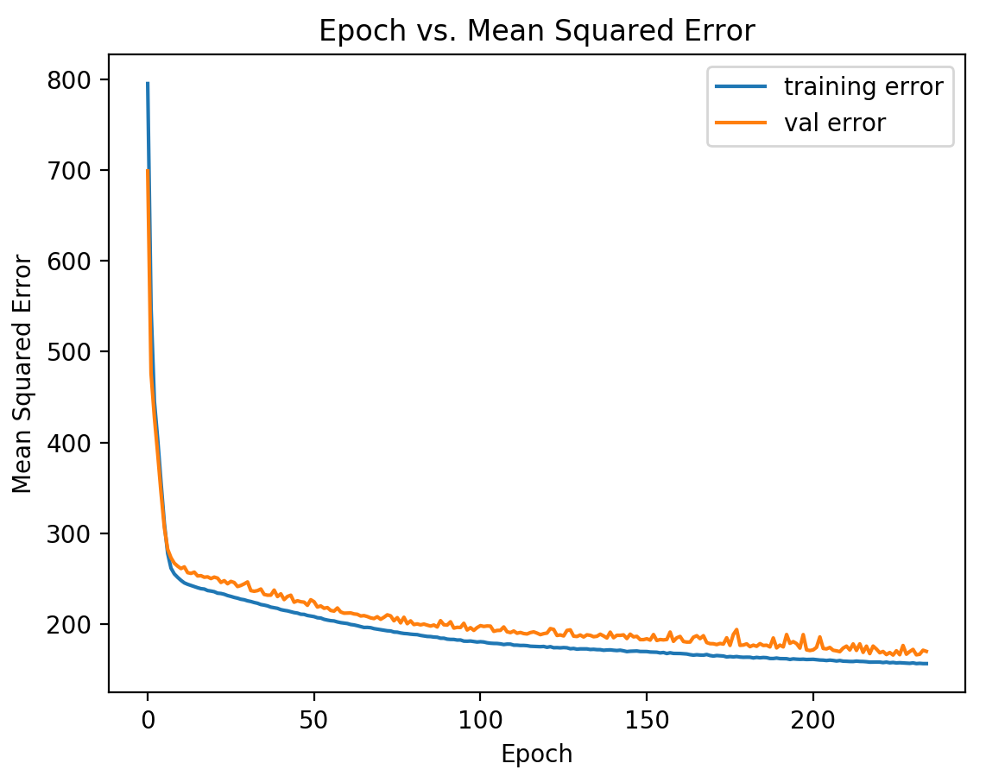
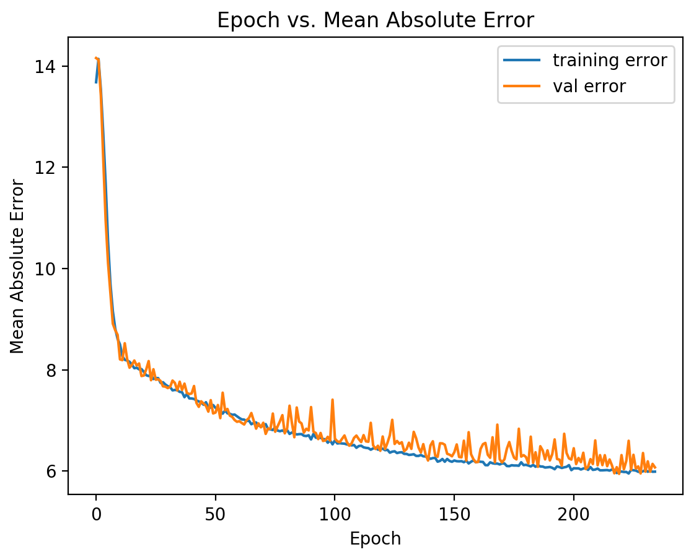
Translation Model Results
Figure 10. Training and validation Mean-Squared error per epoch.
Figure 11. Training and validation Mean-Absolute error per epoch.
Notes:
Minh

Slide 30
Translation Model - Conclusion
Neural network is not yet accurate enough to be used for particle translation.
Inaccuracies may be a result of bad data collection; dataset does not have very well defined relationships.
Next steps
Refine data collection procedure and collect new data
Retrain model, refine neural network architecture, and evaluate model using newly collected data
Notes:
Minh

Slide 31
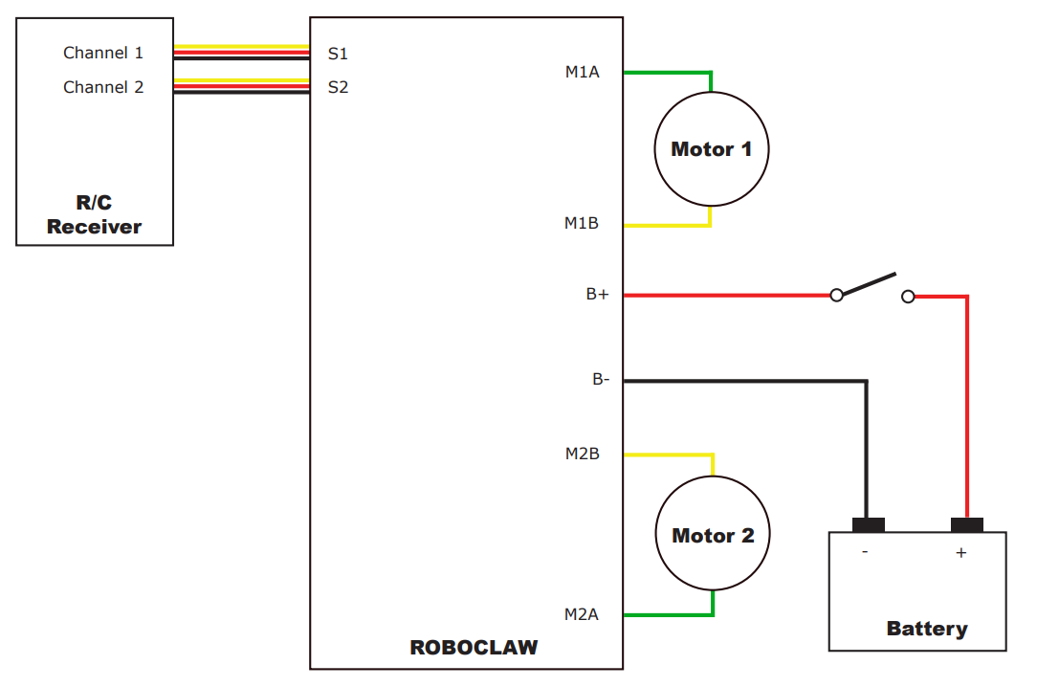
Hardware Final Design
Objective: Seamless communication between graphical user interface and motor controllers.
Motor Controller Control Schemes:
Radio Control
Analog
Simple Serial
Packet Serial
Figure 11. Example RC motor controller connections [2]
Notes:
Bassam

Slide 32
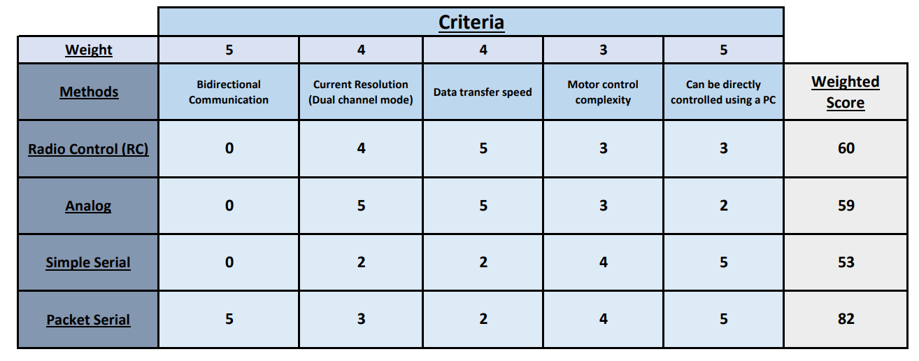
Motor Controller Decision Matrix
Table 6. Roboclaw motor controller control schemes weighted decision matrix.
Notes:
Bassam

Slide 33
Hardware Final Design
Packet Serial Implementation Alternatives:
USB Control
Arduino Control (Two-workers)
Arduino Control (One-worker)
Raspberry Pi Control
Notes:
Bassam

Slide 34
Packet Serial Control Decision Matrix
Table 7. Roboclaw motor controller control schemes weighted decision matrix.
Notes:
Bassam

Slide 35
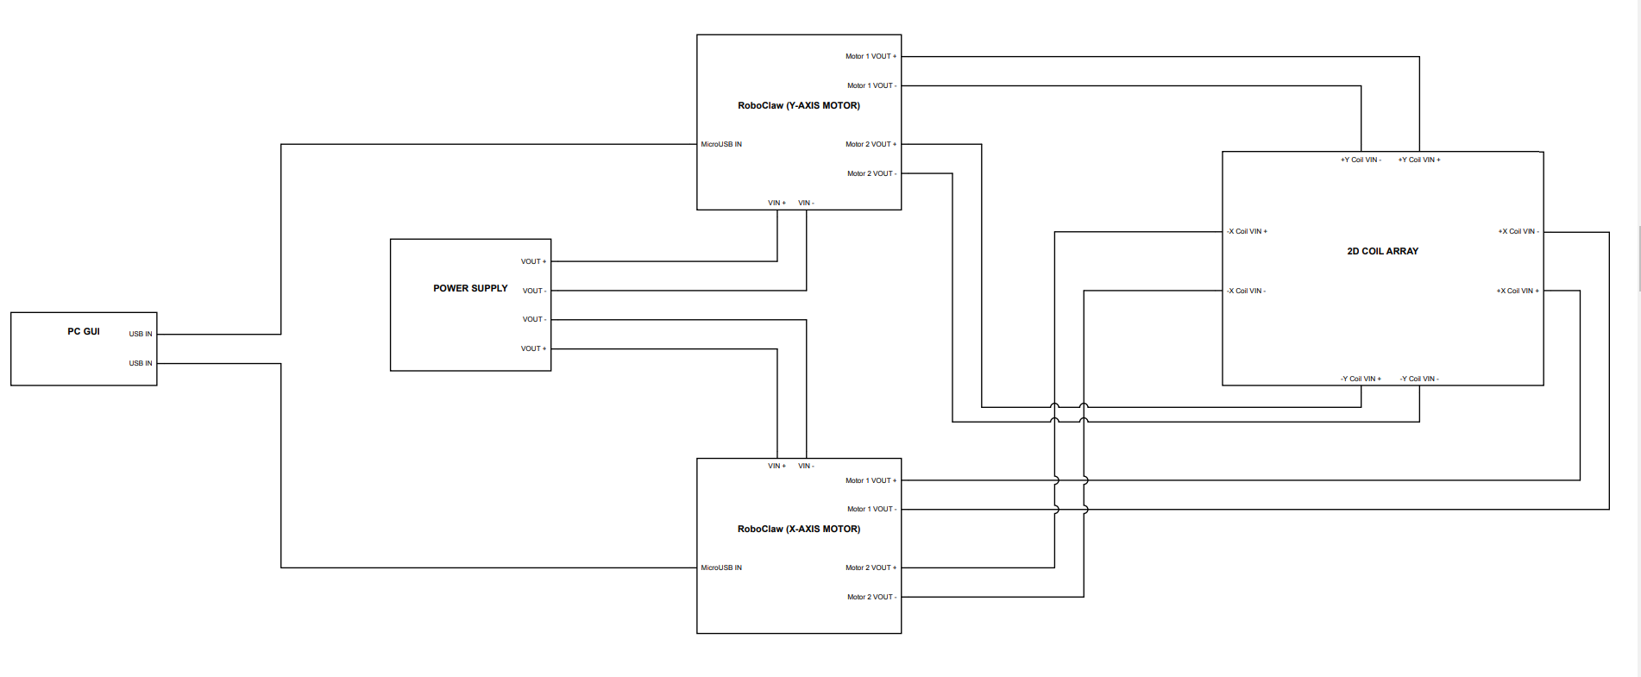
Hardware Wiring Diagram
Figure 12. USB Control Wiring Diagram
Notes:
Bassam

Slide 36
Hardware Testing To-Date
Objective: Attain a measure of consistency between hardware-software communication over a long testing period.
Characterized complete hardware execution time:
Compared expected vs. actual completion time with sub-millisecond precision
Characterized delay in simultaneous motor controller activation:
Recorded the time delay for 500 total commands with a brief 1s pause between commands
Notes:
Bassam

Slide 37
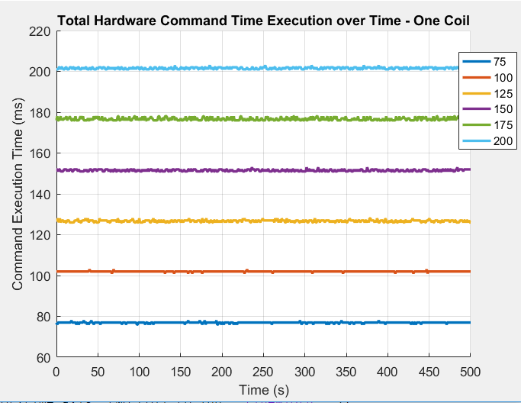
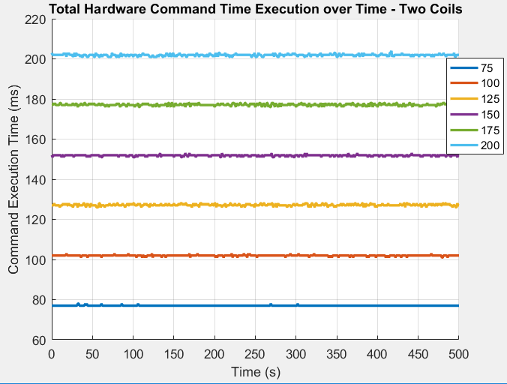
Hardware Testing - Results
Figure 16. Hardware command execution time for one coil activation. Legend depicts total current duration used for each line.
Figure 17. Hardware command execution time for two coil activation
Legend depicts total current duration used for each line.
Notes:
Bassam

Slide 38
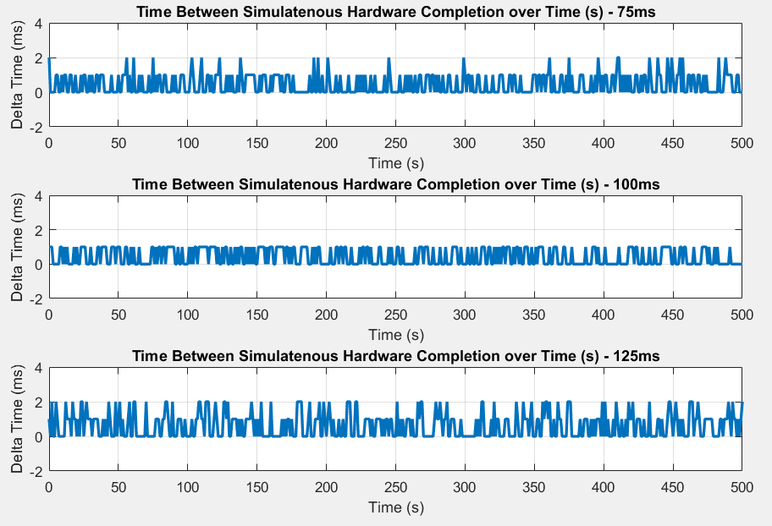
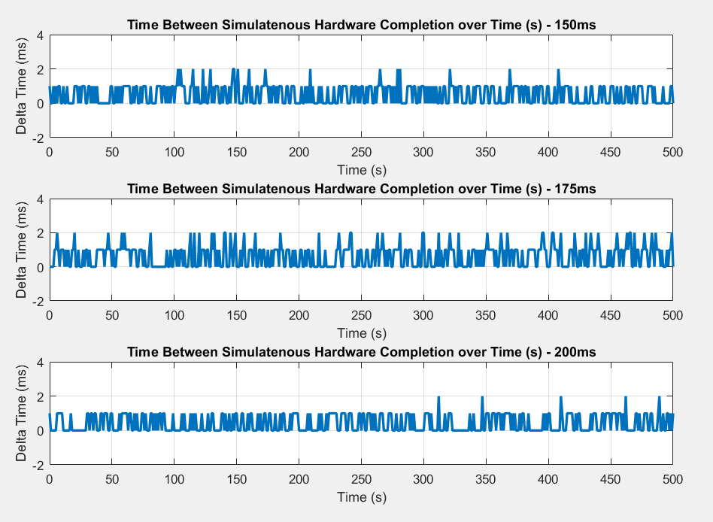
Hardware Testing - Results
Figure 18. Time difference between simultaneous motor controller command completion for 75ms, 100ms, 125ms total current duration.
Figure 19. Time difference between simultaneous motor controller command completion for 150ms, 175ms, 200ms total current duration.
Notes:
Bassam

Slide 39
Work to be Completed
GUI
Design a notifications tab (with system error detection)
Operation and data log generation and refinement
Finalize settings window (Hardware, Image Segmentation, Data Collection)
Deployment from Debug to Release
Particle Translation Model
Reformat neural network architecture
Refine data collection procedure and collect new data
Consider surface mapping alternative
Integrate model into codebase
Notes:
Victor

Slide 40
Work to be Completed (cont.)
Image Segmentation
Consider “global” clean image implementation for image subtraction
Consider particle detection alternatives (neural network, trained kalman filter)
Testing and Evaluation
Conduct GUI user testing
Test GUI performance on sponsor computers
Testing revised translation model implementation
Testing revised particle detection methodology
Notes:
Bassam

Slide 41
Budget-To-Date
Item | Quantity | Cost
Qt Development Environment | 4 | $0
Microsoft Visual Studio 2017 Community | 4 | $0
OpenCV | 4 | $0
Github Version Control | 4 | $0
27V 1.593kW Power Supply * | 1 | $360
ArUco Markers | 4 | $0.50
Roboclaw 2x60A Motor Controllers * | 2 | $400
Ipevo Ziggi USB Camera * | 1 | $148
4-Coil Magnetic Solenoid Array * | 1 | N/A
Micro USB to USB 2.0 | 2 | $10.78
Total Operational Cost |  | $919.28
* Supplied by Weinberg Medical Physics, LLC
Notes:
Minh

Slide 42
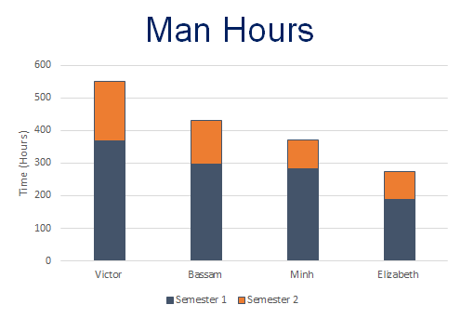
Total Hours (since Fall 2018): 1625.85 hrs
Notes:
Minh

Slide 43
Conclusion
Over this semester, several project components (i.e. GUI, Image Segmentation) received major enhancements
Initial T&E has been performed on project components. Aside from the translation model, results are overall positive.
Immediate next steps are:
remaining GUI development
translation model revamp
particle detection refinement
Notes:
Minh

Slide 44
References
[1] B. Shapiro, S. Kulkarni, A. Nacev, S. Muro, P. Y. Stepanov, and I. N. Weinberg, “Open Challenges in Magnetic Drug Targeting,” Wiley Interdiscip Rev Nanomed Nanobiotechnol, vol. 7, no. 3, pp. 446–457, May 2015.
[2] Ion Motion Control. (2015). Roboclaw 2x60A: Brushed DC Motor Controllers User Manual. Temecula, California
Notes:
Victor

